Slide 1
Hystrix
Krishna babu Ghanta
26 Feb 2018

Slide 2
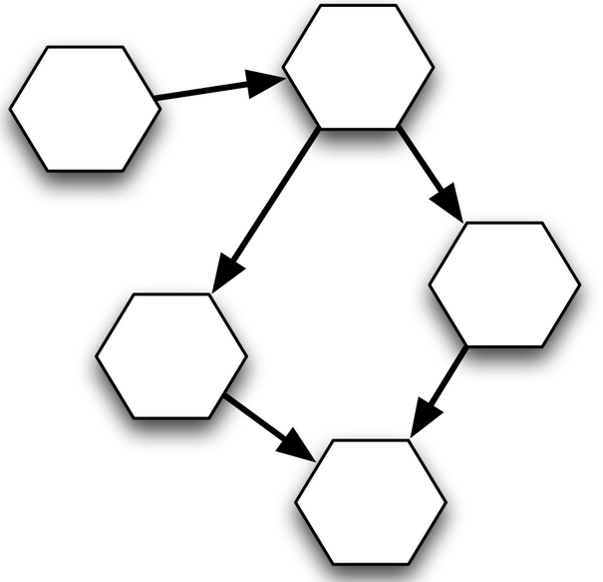
Why Hystrix?
This is what we think ..
Distributed systems / Microservices tend to have problems mostly because of cascading failures…
This is what it may be
in real-time …

Slide 3
Cascading Failure
Having large number of Microservices as dependencies can lead to a “Cascading failures”. If we don’t mitigate this ; Micrservices solution might be a disaster!
Transaction 1 Flow – Blue
Transaction 1 Flow – Black
There will be ripple effect of this failure resulting in cascading failures and thus failure in business transaction
What happens if this mS is in failed state…??

Slide 4
What else can happen when failure ?
When dealing with remote services or APIs there is always the risk of latency issues, failures or connection losses.
The worst thing to happen is when the remote service is down and our application hangs until the underlying protocol’s (e.g. TCP) connection timeout is reached and we’re receiving an exception.
Until this moment is reached, our application might hang, memory is allocated for threads or bound objects and at last, our continuous requests might prevent the remote system from recovering.

Slide 5


Hystrix……What??
Solution is Hystrix…

Slide 6
https://github.com/Netflix/hystrix/wiki
Its all about PRODUCTION
Production
Availability
Resilience
Fault Tolerance
Goals: fault tolerant/robust self-healing applications with zero downtime
Hystrix is a Java library, implementation of resilience patterns.
Built, heavily tested & used in production by Netflix
What is Resilience ? 1. the power or ability to return to the original form, position, etc., after being bent, compressed, or stretched; elasticity.
2. ability to recover readily from illness, depression, adversity, or the like; buoyancy.

Slide 7
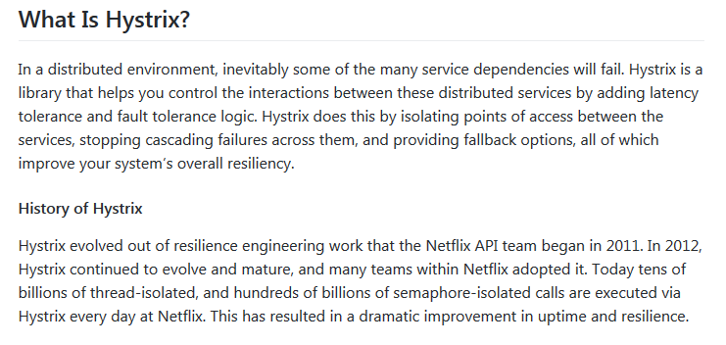
Hystrix and its history…

Slide 8
Solution design patterns for mS Resiliance
Supported patterns by Hystrix
Circuit breaker pattern to avoid cascading failures
Bulkheads : The bulkhead implementation in Hystrix limits the number of concurrent calls to a component. This way, the number of resources (typically threads) that is waiting for a reply from the component is limited. Hystrix has two different approaches to the bulkhead, thread isolation and semaphore isolation.
Fail fast
Graceful degradation of Service
Failover
Escalation
Retry
….and so on

Slide 9
Why not Try-Catch
Yes, it can be simply wrapped under try-catch block then why choose Hystrix or some other library?
Already test proven library.
Ability to skip original intended calls and fallback.
Note that if you wrap it under try-catch, there will be still be an attempt to connect and send command which will eventually timeout due to degraded dependency.
Knowing this information prior to call will enable to skip the calls for sometime (as per configuration) and you can save those resources.
Provides circuit breaking using Sliding Time Window as well
Metrics and Dashboarding provided Out of the Box which can help you peek into your system and dependent connection
Implements BulkHead by using different Thread Pools
Lower maintenance cost
Health check ability. It provides a health check class which plugins with Health monitoring APIs

Slide 10
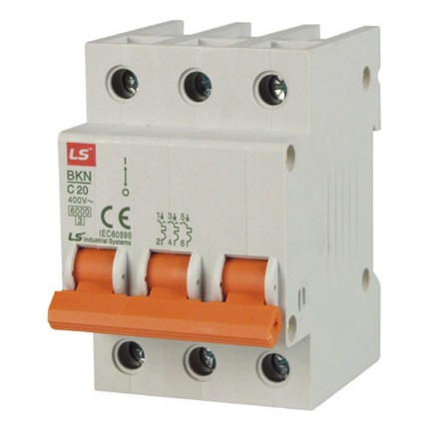
Circuit breaker
Like our household circuit breaker detects failure conditions and "opens" to disallow further calls.
When Error rate hits the threshold, the circuit opens
Hystrix defaults : 20 failures in 5 seconds
Identify "fallback" - What to do in case of a service dependency failure
Automatically "closes" itself after interval
Hystrix defult - 5 seconds

Slide 11
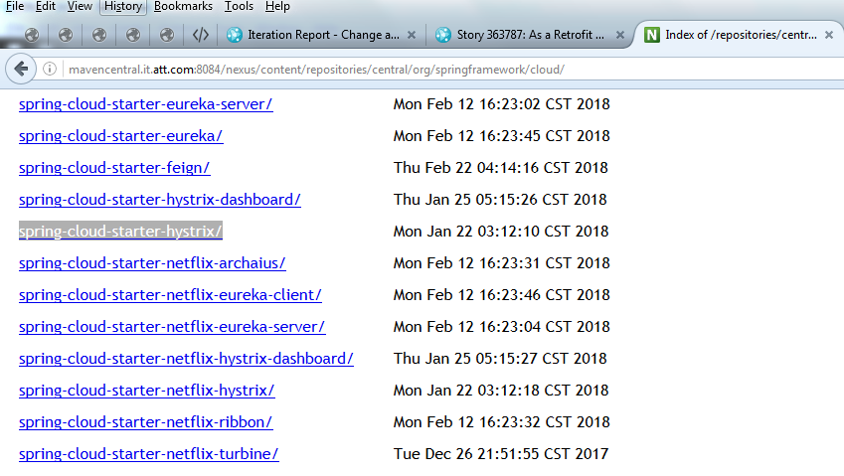
Hystrix Setup
Just add the dependency from At&T Nexus to your POM

Slide 12
Setup Hystrix
Just add the dependency from At&T Nexus to your POM
<dependency>
<groupId>org.springframework.cloud</groupId>
<artifactId>spring-cloud-starter-hystrix</artifactId>
<version>1.1.5.RELEASE</version>
</dependency>
<dependency>
<groupId>org.springframework.cloud</groupId>
<artifactId>spring-cloud-starter-hystrix-dashboard</artifactId>
<version>1.1.5.RELEASE</version>
</dependency>
Simply switch Hystrix on in your configuration file
@SpringBootApplication
@EnableHystrix
@EnableHystrixDashboard
@ComponentScan(basePackages = {"com.att"})
public class Application extends SpringBootServletInitializer {
@Override
protected SpringApplicationBuilder configure(SpringApplicationBuilder application) {
return application.sources(Application.class);
}

Slide 13
@HystrixCommand
Use @HystrixCommand to wrap methods in a circuit breaker
Based on recent failures Hystrix will call one of these two methods
fallbackMethod must have same signature(parameters and return types) as primary.
@HystrixCommand can be called in various ways Synchronously , Asynchronusly , Reactively
Failure / Recovery behavior is highly customizable with @HystrixProperty
Javanica documentation talks more about all important properties.
https://github.com/Netflix/Hystrix/tree/master/hystrix-contrib/hystrix-javanica
https://github.com/Netflix/Hystrix/tree/master/hystrix-contrib/hystrix-javanica
https://github.com/Netflix/Hystrix/wiki/Configuration

Slide 14
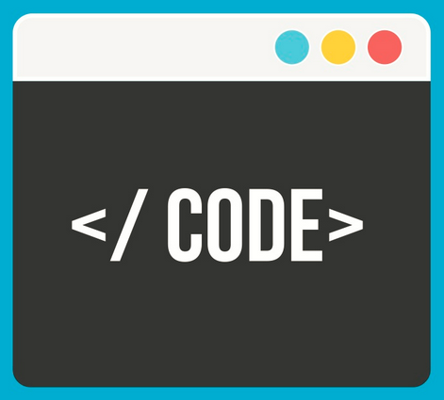
Use-Case & Demo
mS1 – EnterpriceOrder
createOrder()
Send OrderID , customerInfo to mS2 - getOrderInfo() to get orderInfo
mS2 – OrderInfoValidator – Implements Hystrix Circuit breaker at this while calling getValidatedAddress
Implement Hystrix at the validateOrder method to fallback quickly and avoid cascading failures
with autoValidate logical method
mS3- AddressValidator
getValidatedAddress(unparsedAddress){
return validatedAddress;
}
http://localhost:9091/eo/validate
mS1
mS2
http://localhost:9090/eo/create
mS3
http://localhost:9092/eo/address
https://github.com/krishnabab/OrderValidator.git

Slide 15
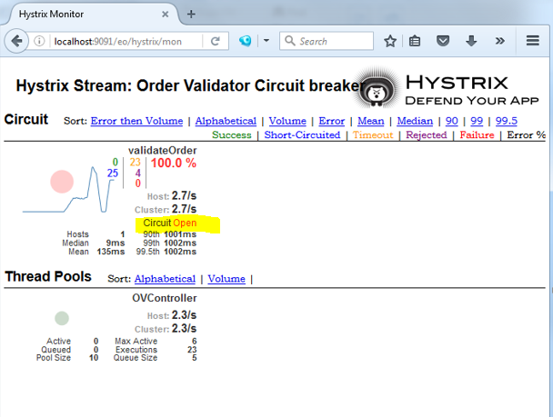
Hystrix - Dashboard
Hystrix provides a built in dashboard to check the status of the circuit breaker
Accessing Hystrix dashboard
http://<host>:<port>/hystrix
http://<host>:<port>/hystrix.stream

Slide 16
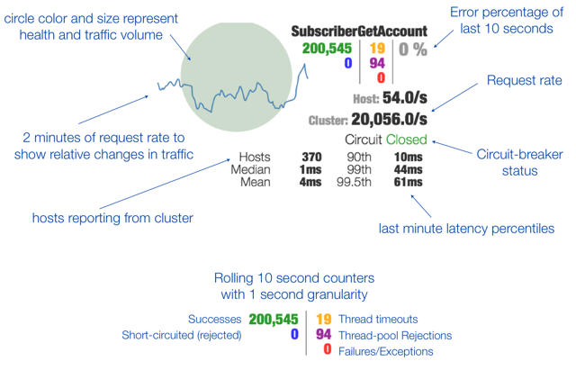
Understanding Hystrix – Dashboard

Slide 17
Turbine
Looking at an individual instances Hystrix data is not very useful in terms of the overall health of the system.
Turbine is an application that aggregates all of the relevant /hystrix.stream endpoints into a combined /turbine.stream for use in the Hystrix Dashboard. Running Turbine is as simple as annotating your main class with the @EnableTurbine annotation (e.g. using spring-cloud-starter-turbine to set up the classpath).
Monitoring large number of hystrix dashboards is not really practical, so Turbine helps you to consolidate the streams and show it on one dash board
Gather metrics from the individual instances and share in one place

Slide 18

Questions ??

Slide 19

References and further reading
https://github.com/Netflix/hystrix/wiki
https://github.com/Netflix/Hystrix/wiki/FAQ-:-General
https://github.com/Netflix/Hystrix/wiki/Configuration
https://medium.com/netflix-techblog/tagged/hystrix
https://github.com/spring-projects/spring-boot/issues/8186
https://github.com/Netflix-Skunkworks/hystrix-dashboard
https://medium.com/netflix-techblog/hystrix-dashboard-turbine-stream-aggregator-60985a2e51df
https://exampledriven.wordpress.com/2016/07/05/spring-cloud-hystrix-example/
https://github.com/Netflix/Hystrix/issues/332

Slide 20
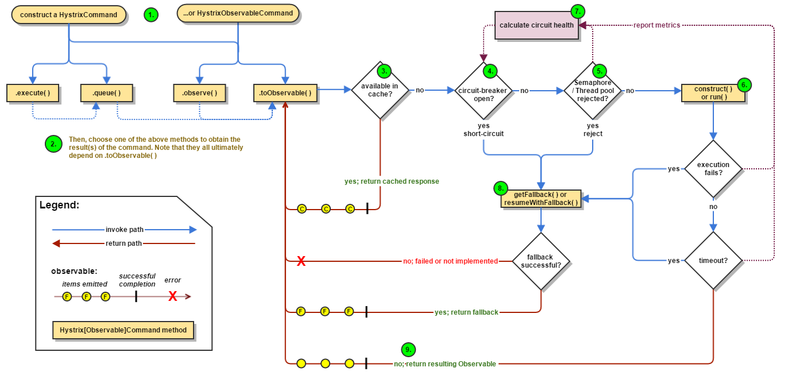
How Hystrix works ?
https://github.com/Netflix/Hystrix/wiki/How-it-Works

